Slide 1
AGILE & SCRUM
Ashish Gupta
Notes:
‹#›

Slide 2
AGILE Mindset
The Agile Mindset, essentially, is a movement away from traditional, bureaucratic leadership (which can involve office politics and a “whoever is loudest is right” mentality). Instead, the agile mindset has teams put aside ego, and focus on what is right, instead of who is right.
Agile has evolved into more than just software related tasks and has branched out into an actual style of management.
Innovation
Emphasis on customer value
Self- organized teams
Networking and collaboration
Notes:
‹#›

Slide 3
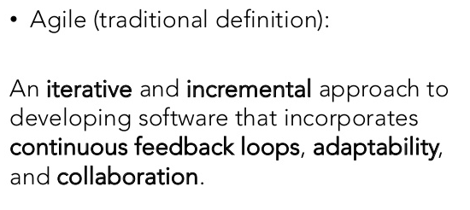
AGILE-Definition & Manifesto
Individuals and interactions over processes and tools
Working software over comprehensive documentation
Customer collaboration over contract negotiation
Responding to change over following a plan
Notes:
‹#›

Slide 4
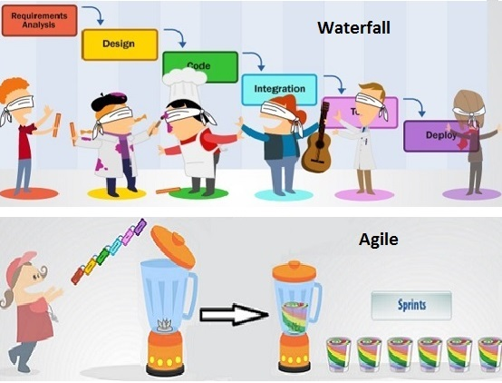
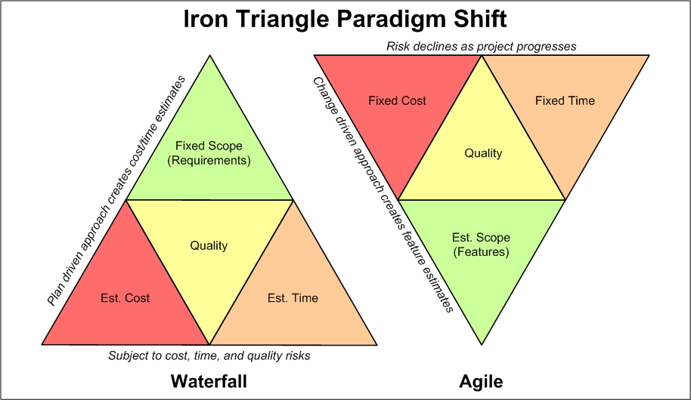
AGILE-How it is different from Traditional
Notes:
‹#›

Slide 5
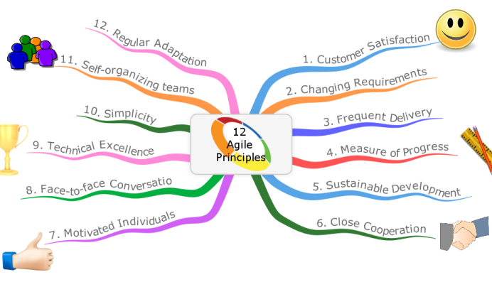
AGILE PRINCIPLES
Notes:
‹#›
Customer satisfaction is the top priority.
Embrace logical change at every step of the project.
Create working deliverables then gradually improve them.
Business and tech people need to work together.
Build projects around motivated teams to produce quality results.
Face to face communication is preferred over other forms of interaction.
A working product is the best measure of success.
Aim for a sustainable pace of development.
Invest sufficient time to produce quality products.
There is power in simplicity.
Self-organizing teams are ideal.
You can learn valuable lessons from both failure and success.

Slide 6
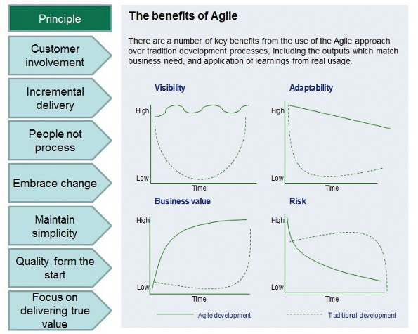
AGILE
Agile Benefits
Notes:
‹#›

Slide 7
SCRUM and Scrum Pillar
Definition: A framework within which people can address complex adaptive problems, while productively and creatively delivering products of the highest possible value.
Scrum is founded on empirical process control theory, or empiricism. Empiricism asserts that knowledge comes from experience and making decisions based on what is known.
Three Pillars:
Transparency - common understanding what is being done, definition of done
Inspection - frequently inspect Scrum artifacts and progress toward a Sprint Goal to detect undesirable variances.
Adaptation - An adjustment must be made as soon as possible to minimize deviation
Notes:
‹#›
Copyright 2012 Fujitsu Consulting India

Slide 8
SCRUM Values
When the Values of Commitment, courage, Focus, Openness, Respect are embodied and lived by scrum team, three pillars - Transparency, Inspection, Adaptation come to life and build trust for every one
The Scrum Team members learn and explore those values as they work with the Scrum events, roles and artifacts.
Features Of Scrum Scrum Team
Time Box Cross Functional
Incremental Self Organized
Business Driven
Feedback Oriented
Notes:
‹#›

Slide 9
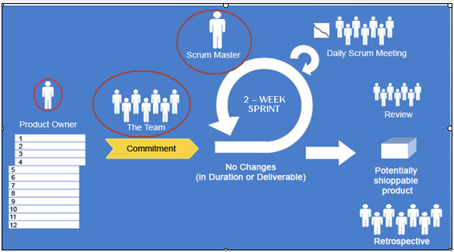
SCRUM
Notes:
‹#›

Slide 10
SCRUM-FRAMEWORK
Roles
Product Owner
Scrum Master
Team
Stakeholders
Ceremonies
Sprint Planning
Daily Scrum Meeting
Sprint Review
Sprint Retrospective
Artifacts
User Stories
Product Backlog
Sprint Backlog
Burn Down Charts
Notes:
‹#›

Slide 11
SCRUM Roles - Product Owner
Product Backlog
The Product Backlog is an ordered list of everything that might be needed in the product and is
the single source of requirements for any changes to be made to the product. The Product
Owner is responsible for the Product Backlog, including its content, availability, and ordering.
Product Owner:
The Product Owner is the sole person responsible for managing the Product Backlog. Product
Backlog management includes:
Clearly expressing Product Backlog items;
Ordering the items in the Product Backlog to best achieve goals and missions;
Optimizing the value of the work the Development Team performs;
Ensuring that the Product Backlog is visible, transparent, and clear to all, and shows what
the Scrum Team will work on next; and,
Ensuring the Development Team understands items in the Product Backlog to the level
needed.
The Product Owner may do the above work, or have the Development Team do it. However, the
Product Owner remains accountable.
Notes:
‹#›

Slide 12
SCRUM Roles - Development Team
The Development Team consists of professionals who do the work of delivering a potentially
releasable Increment of “Done”product at the end of each Sprint. Only members of the
Development Team create the Increment.
Development Teams have the following characteristics:
They are self-organizing. No one (not even the Scrum Master) tells the Development Team
how to turn Product Backlog into Increments of potentially releasable functionality;
Development Teams are cross-functional, with all of the skills as a team necessary to create
a product Increment;
Scrum recognizes no titles for Development Team members other than Developer,
regardless of the work being performed by the person;there are no exceptions to this rule;
Scrum recognizes no sub-teams in the Development Team, regardless of particular domains
that need to be addressed like testing or business analysis; there are no exceptions to this
rule; and,
Individual Development Team members may have specialized skills and areas of focus, but
accountability belongs to the Development Team as a whole.
Development team Size 3-9 People
Notes:
‹#›

Slide 13
SCRUM Roles - Scrum Master
Scrum Master Service to the Product Owner
The Scrum Masters serves the Product Owner in several ways, including:
Finding techniques for effective Product Backlog management;
Helping the Scrum Team understand the need for clear and concise Product Backlog items;
Understanding product planning in an empirical environment;
Ensuring the Product Owner knows how to arrange the Product Backlog to maximize value;
Understanding and practicing agility; and,
Facilitating Scrum events as requested or needed.
Scrum Master Service to the Development Team
The Scrum Master serves the Development Team in several ways, including:
Coaching the Development Team in self-organization and cross-functionality;
Helping the Development Team to create high-value products;
Removing impediments to the Development Team’s progress;
Facilitating Scrum events as requested or needed; and,
Coaching the Development Team in organizational environments in which Scrum is not yet
fully adopted and understood.
Notes:
‹#›

Slide 14
SCRUM Roles - Scrum Master
Scrum Master Service to the Organization
The Scrum Master serves the organization in several ways, including:
Leading and coaching the organization in its Scrum adoption;
Planning Scrum implementations within the organization;
Helping employees and stakeholders understand and enact Scrum and empirical product
development;
Causing change that increases the productivity of the Scrum Team; and,
Working with other Scrum Masters to increase the effectiveness of the application of Scrum
in the organization.
Notes:
‹#›

Slide 15
SCRUM Events-Sprint
Sprint: The heart of Scrum is a Sprint, a time-box of one month or less during which a “Done”, useable, and potentially releasable product Increment is created.
Sprints contain and consist of the Sprint Planning, Daily Scrums, the development work, the Sprint Review, and the Sprint Retrospective.
A new Sprint starts immediately after the conclusion of the
previous Sprint.
During the Sprint:
No changes are made that would endanger the Sprint Goal;
Quality goals do not decrease; and,
Scope may be clarified and re-negotiated between the Product Owner and Development Team as more is learned.
A Sprint can be cancelled before the Sprint time-box is over. Only the Product Owner has the authority to cancel the Sprint, although he or she may do so under influence from the stakeholders, the Development Team, or the Scrum Master.
Notes:
‹#›

Slide 16
SCRUM - Sprint Planning
The work to be performed in the Sprint is planned at the Sprint Planning. This plan is created by the collaborative work of the entire Scrum Team.
Sprint Planning is time-boxed to a maximum of eight hours for a one-month Sprint.
What can be delivered in the Increment resulting from the upcoming Sprint?
How will the work needed to deliver the Increment be achieved?
The input to this meeting is the Product Backlog, the latest product Increment, projected capacity of the Development Team during the Sprint, and past performance of the Development Team. The number of items selected from the Product Backlog for the Sprint is solely up to the Development Team.
Only the Development Team can assess what it can accomplish over the
upcoming Sprint.
The Sprint Goal is an objective that will be met within the
Sprint through the implementation of the Product Backlog, and it provides guidance to the Development Teamon why it is building the Increment.
Notes:
‹#›

Slide 17
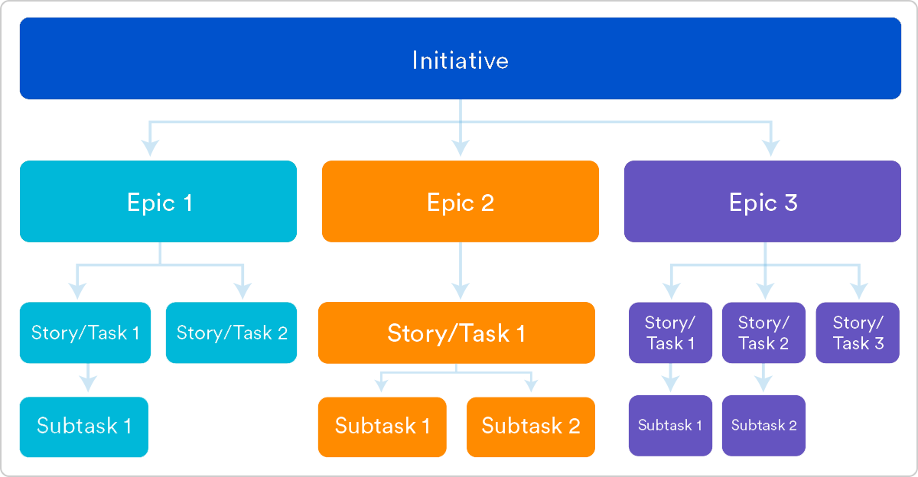
Agile Requirements - User Story
“As a [persona], I [want to], [so that].”
As a manager, I want to be able to understand my colleagues progress, so I can better report our success and failures.
Definition of “done”
Outline subtasks or tasks
Ordered Steps
Owner
Time
Notes:
‹#›

Slide 18
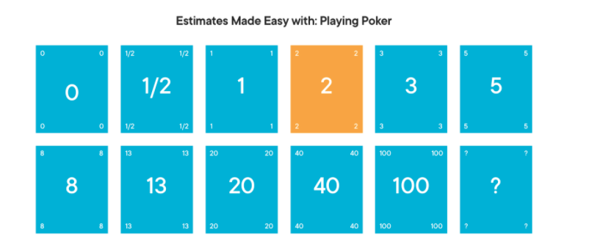
Agile Estimation- Story Point- Planning Pocker
Number-coded playing cards are used to estimate an item. The cards are distributed across the team (sized 2-10), with each of the cards representing a valid estimate.
The reading on the cards could be something such as — 0, 1, 2, 3, 5, 8, 13, 20, 40, and 100. Now, the product owner or the analyst describes the user story to the team, and the team can ask any related queries
Each team member secretly selects a card number for an estimate, which is revealed when all the cards are turned over. The card with the most voting is the finalized estimate for the item under discussion. In case of uneven estimates, meetings are held, and the next round of voting commences to come up with an estimate everyone agrees with.
Notes:
‹#›

Slide 19
SCRUM - The Scrum
The Daily Scrum is a 15-minute time-boxed event for the Development Team to synchronize activities and create a plan for the next 24 hours.
The Daily Scrum is held at the same time and place each day to reduce complexity.During the meeting, the Development Team members explain:
What did I do yesterday that helped the Development Team meet the Sprint Goal?
What will I do today to help the Development Team meet the Sprint Goal?
Do I see any impediment that prevents me or the Development Team from meeting the Sprint Goal?
Daily Scrums improve communications, eliminate other meetings, identify impediments to development for removal, highlight and promote quick decision-making, and improve the Development Team’s level of knowledge. This is a key inspect and adapt meeting.
Notes:
‹#›

Slide 20
SCRUM - Sprint Review
Sprint Review held at end of the sprint to inspect the Increment and adapt the Product Backlog if needed.
the Scrum Team and stakeholders collaborate about what was done in the Sprint.
This is a four-hour time-boxed meeting for one-month Sprints.
Attendees include the Scrum Team and key stakeholders invited by the Product Owner
The Product Owner explains what Product Backlog items have been “Done” and what has not been “Done”;
The Development Team discusses what went well during the Sprint, what problems it ran into, and how those problems were solved;
The Development Team demonstrates the work that it has “Done” and answers questions about the Increment;
The entire group collaborates on what to do next, so that the Sprint Review provides valuable input to subsequent Sprint Planning;
Review of how the marketplace or potential use of the product might have changed what is the most valuable thing to do next; and,
Review of the timeline, budget, potential capabilities, and marketplace for the next anticipated release of the product.
Notes:
‹#›

Slide 21
SCRUM - Sprint Retrospective
This is a three-hour time-boxed meeting for one-month Sprints.
The purpose of the Sprint Retrospective is to:
Inspect how the last Sprint went with regards to people, relationships, process,and tools;
Identify and order the major items that went well and potential improvements;
Create a plan for implementing improvements to the way the Scrum Team does its work.
Notes:
‹#›

Slide 22
MANAGER 2.0
Decide task assignments among the team members and assign them | Provide coaching and mentorship to team-members
Keep track of whether team-members have done the tasks I’ve assigned to them | Surface issues to the team that they might overlook – scaling, performance, security, etc.
Make commitments on behalf of the team about how much they can get done by X date | Provide input on features, functionality, and other aspects of what’s being produced
Give direction to the team on how to do the work, so they can meet the commitment I made | Do performance evaluations and provide feedback to team-members
Convince team that the commitments made on their behalf are attainable | Provide advice and input to the team on difficult technical issues that come up
Monitor the team's progress, to make sure they stay on schedule, and aren't having problems | Plan training for team, and do career-development and planning with team-members
Conduct weekly update and 1:1 meetings with team, to surface issues, and provide direction | Stay abreast of latest developments in the technology their team uses, industry news, etc
Recruit, interview and hire new members of the team | Plan and oversee budgets and financials, and think about tools, skills and other future needs
Fire team-members who are consistently not able to perform | Help remove impediments that the team is not able or well-placed to resolve themselves
Notes:
‹#›

Slide 23
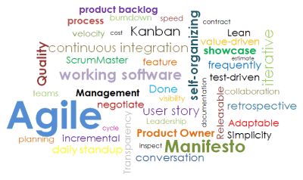
AGILE-Key Terms

Slide 24
Q & A
Q & A

